Slide 1
Lecture 4: Stack, Queue, and VLSI Floorplan
Dr. Tsung-Wei Huang
Department of Electrical and Computer Engineering
University of Utah, Salt Lake City, UT
Notes:
Alright, so we have spent roughly two weeks talking about the divide and conquer. It is essentially a technique to solve large problem. (explain … )

Slide 2
Recap Sorting
Complexity of popular sorting algorithms
Bubble Sort | O(n²)
Insert Sort | O(n²)
Selection Sort | O(n²)
Quick Sort | Average O(n log n)
Merge Sort | O(n log n)
Heap Sort | O(n log n)
Radix Sort | O(n log n)
Notes:
We talked about many applications of divide and conquer, including sorting, the most fundamental component for all computational problems. Because of its importance, there are just too many sorting algorithms available in the world.
For example, we have bubble sort, that is a N square algorithm, insertion sort we talked about last time and that is also a N square algorithm, selection sort, quick sort, merge sort we talked about last time using divide and conquer to get a NlogN speed, other sorting algorithms include heap sort, radix sort, and so on so forth.

Slide 3
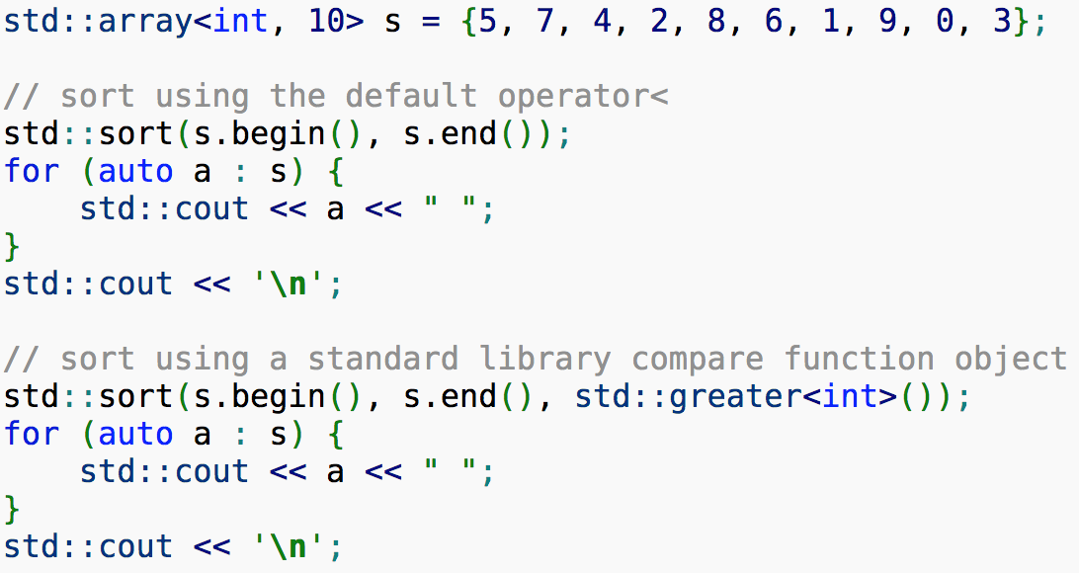
In fact, what you need may be …
Use std::sort in 90% problems
https://en.cppreference.com/w/cpp/algorithm/sort
Notes:
The question is, there are so many sorting algorithms, which one I should use? Do I use bubble sort, or merge sort or quick sort? Well, the answer is NOT depend, in fact, waht you need is, for 90% of the problems, std::sort, and that's the sorting algorithm in C++ standard library. It's very fast, and it is a mix of different algorithms together to sort the items. Fast enough, most of cases, std::sort is more than enough. So, just use it. But it's always to understand how divide and conquer can help sort. Actually, std::sort applies divide and conquer to some extent.
(explain...)

Slide 4
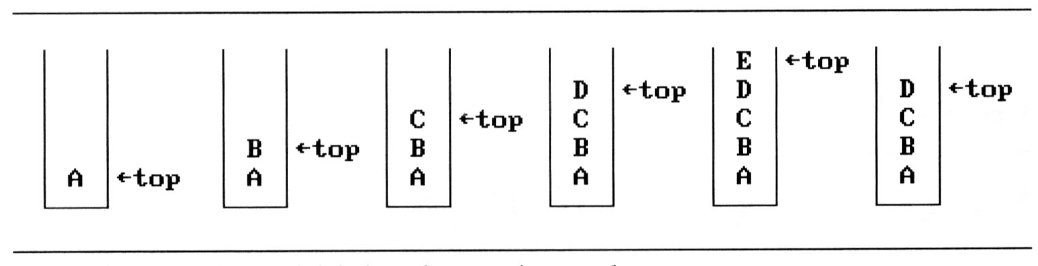
Stack
A stack is an ordered list in which insertions and deletions are made at one end called the top
Support push and pop operations and top query
A stack is also known as a Last-In-First-Out (LIFO) list
If we add the elements A, B, C, D, E to the stack, in that order, then E is the first element we delete from the stack
Notes:
Now, we are moving to a new series. We are going to spend time talking about some fundamental data structures. A data structure is nothing but a collection of items to support insertion, deletion, and query. Insertion inserts a new item to the collection, deletion removes an item from the collection, and query asks for an item from the collection. All operations follow certain orders and different data structures have different orders.
The first data structure we are going to talk about is stack. A stack is an ordered ... (follow)

Slide 5
Visualization of Stack
Main Subroutine
Push
Pop
Top
a₃
a₃
a₂
a₂
a₁
a₁
a₀
a₀
Push (Add)
Pop (Delete)
Notes:
You can image stack is simply a linear array that maintains a bunch of items in a first-in-last-out order or last-in-first-out order.

Slide 6
std::stack
C++ Standard Template Library (STL) stack
https://en.cppreference.com/w/cpp/container/stack
/* stack example */
#include <iostream>
#include <stack>
int main()
{
std::stack<int> stk;
stk.push(1);
stk.push(2);
std::cout<<stk.top();
/* clear the stack */
while(!stk.empty())
stk.pop();
}
Notes:
Good news is the standard template library (STL) has provided us a stack implementation. It's a template library for you to create a stack to hold arbitrary types of items. The usage is as follows: (include -> template -> push -> query -> drain out all items)
You may find more useful information at the official stack reference. That page has a very clear explanation about each method defined in the stack and the meaning of each API.

Slide 7
Application: Recursion Stack Frame
stack frame of recursive function call
fp
al
(activation record)
fp: a pointer to current stack frame
fp
main
stack frame of invoking function
system stack before a1 is invoked
system stack after a1 is invoked
Notes:
Stack has a lot of applications. One of them is recursion. (explain recurse A->B->C)

Slide 8
All recursive algorithm can be rewritten iteratively using either flat for-loop or stack
Notes:
So, there is a very famous statement, I am not saying it's an official theory, but an engineering statement: All recursive algorithm ... (follow)
And, why are we doing this? The main reason to unroll a recursive problem using stack and write it iteratively is performance. (explain)

Slide 9
Queue
A queue is an ordered list in which insertions and deletions are made at one end called the rear and front
Support push and pop operations and front query
A queue is also known as a First-In-First-Out (LIFO) list
If we add the elements A, B, C, D, E to the queue, in that order, then A is the first element we delete from the queue
a₀
a₁
a₂
a_{n-1}
front
rear
Notes:
Another data structure in the opposite direction to stack is queue. Similar to stack, queue is a data structure that supoprts push and pop operations to insert and remove items into and from a collection. A queue is an (follow...)

Slide 10
Visualization of Queue
Main Subroutine
Push
Pop
front
a₃
a₃
a₂
a₂
a₁
a₁
a₀
a₀
Push (Add)
Pop (Delete)
Notes:
Again, you can imagine queue is a linear array that support three operations, push, pop, and front. push is an operation to insert a new item to the queue, pop is an operation to remove an existing item from the queue, and front is an operation to query the first item in the queue. (explain...)

Slide 11
std::queue
C++ Standard Template Library (STL) queue
https://en.cppreference.com/w/cpp/container/queue
#include <iostream>
#include <queue>
int main()
{
std::queue<int> que;
que.push(1);
que.push(2);
std::cout<<que.front();
/* clear the queue */
while(!que.empty())
que.pop();
}
Notes:
Like stack, the c++ standard template library STL has provided us an implementation of queue. It's a template for you to create a stack of literally arbitrary types of items. You can find more information about the API and usage of each method in the official reference manual.
A simple usage is as follows: (explain ... )

Slide 12
Example: Parenthesis Problem
Given a string of characters '(', ')', '{', '}', '[' and ’]’
Goal: Determine if the input string is valid.
An input string is valid if:
Open brackets must be closed by the same type of brackets.
Open brackets must be closed in the correct order.
Note that an empty string is also considered valid.
() | valid
()[]{} | valid
(] | invalid
([)] | invalid
{[]} | valid
Notes:
Now let's take a look at some example. The example we are looking at is the "Parenthesis Problem". This is a very important problem in computer science and engineering. IT is also the top 100 list of questions in job interview.
You are given a string of characters each made of three types of parentheses. The normal parenthesis, bracket, and square bracket. Each parenthesis has a pair to match, the opening parenthesis and the closing parenthesis. Similarly, we have opening bracket and closing bracket, and opening square bracket and closing square bracket.
So, you are given a string of these characters, and your job is to tell whether these strings or expressions are valid or not. (follow ... )

Slide 13
Applications
A fundamental routine in language compiler
Need to parse a valid mathematical expressions
(3+2)*4*((9-6)/6)
(double)(1)/(2+7)
Need to parse a valid code block
int main () { return 0; }
void function() {}
auto lambda = [] () { my_work(); }
Also a very frequently asked question in interview …
Notes:
Why is this problem important? Well, this parenthesis checking problem is essential for many applications. It's a fundamental routine in the design and implementation of language compiler and systems. For example, (explain...)
Because of the importance, this question is frequently asked by many software companies. And I remembered this is the question I was asked during the qualification example of my PhD career.

Slide 14
So, by how?
() | valid
()[]{} | valid
(] | invalid
([)] | invalid
{[]} | valid
(((((()))))) | valid
()()()() | valid
(((((((() | invalid
((()(()))) | valid
[](){(}} | invalid
Notes:
So, let's review more examples. (explain...)
How can we solve this problem?

Slide 15
Property
A valid expression must imply:
All subexpressions are valid
Notes:
An interesting property about a valid parenthesis expression is that a sub-expression of a valid expression should also be a valid expression. (Not every sub-expression) e.g.
Also, if you look at the above structure carefully, the color coded cells mark the opening and closing pairs of parenthesis. The entire expression is valid, and sub portions of it are also valid in themselves. This lands a sort of a recursive structure to the problem. For e.g. Consider the expression enclosed within the two green parenthesis in the diagram above. The opening bracket at index 1 and the corresponding closing bracket at index 6.

Slide 16
Recursive Validness
Remove yellow pair

Slide 17
Recursive Validness
Remove purple pair

Slide 18
Recursive Validness
Remove green pair

Slide 19
Recursive Validness
Every subexpression is valid
Notes:
The stack data structure can come in handy here in representing this recursive structure of the problem. We can't really process this from the inside out because we don't have an idea about the overall structure. But, the stack can help us process this recursively i.e. from outside to inwards.

Slide 20
All recursive algorithm can be rewritten iteratively using either flat for-loop or stack
Notes:
Well, this idea is simple but the implementation is actually not very easy. (explain … )
The above solution is very inefficient compared to stack based solution we are going to talk about in the next slide. This seems only useful for recursion practice problems.

Slide 21
Algorithm
Initialize a stack S.
Process each bracket of the expression one at a time.
If we encounter an opening bracket, we simply push it onto the stack. This means we will process it later, let us simply move onto the sub-expression ahead.
If we encounter a closing bracket, then we check the element on top of the stack. If the element at the top of the stack is an opening bracket of the same type, then we pop it off the stack and continue processing. Else, this implies an invalid expression.
In the end, if we are left with a stack still having elements, then this implies an invalid expression.
Notes:
Let us have a look at the algorithm for this problem using stacks as the intermediate data structure. This problem is a very great example that demonstrate recurion may not be always the easiest way to solve a problem with the recursive structure. So the algorithm is as follows:

Slide 22
Illustration
Notes:
We'll have a look a dry run for the algorithm and then move onto the implementation.

Slide 23
Illustration

Slide 24
Illustration

Slide 25
Illustration

Slide 26
Illustration

Slide 27
Illustration

Slide 28
Illustration

Slide 29
Illustration

Slide 30
Illustration

Slide 31
Illustration

Slide 32
Illustration

Slide 33
Illustration

Slide 34
Complexity
Time complexity : O(n)
We traverse the given string one character at a time and push and pop operations on a stack take O(1) time.
Space complexity : O(n)
We push all opening brackets onto the stack and in the worst case, we will end up pushing all the brackets onto the stack. e.g. ((((((((((.

Slide 35
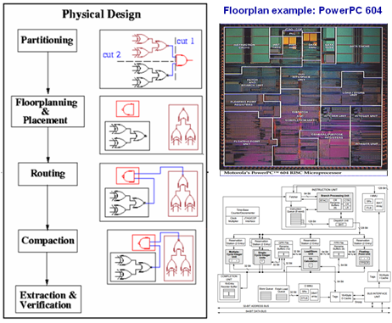
Design Automation Flow of IC
Notes:
Now we are going to take a look at another important application of stack in design automation flow of circuits. Remember in the first class, we talked about the IC design flow, logic synthesis, and physical synthesis. One important area is physical design. You are given a circuit netlist that is a bunch of gates with connectivity. (explain...)

Slide 36
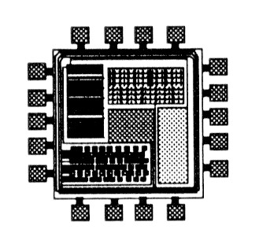
Physical Layout Representation Model
Several blocks after partitioning
Need to put these blocks together
Notes:
After partition, we have several blocks. And we need to place these blocks in circuit. Definitely, we want to make them as packed as possible. We want to minimize the area. Nobody wants to bring a huge smart phone everyday.

Slide 37
Floorplanning
The floorplanning problem is to plan the positions and shapes of the modules at the beginning of the design cycle to optimize the circuit performance…
chip area
total wirelength
delay of critical path
routability
others, ex: noise, heat dissipation, …
Notes:
This is the problem of floorplanning. (follow ... )

Slide 38
Floorplanning Problem Formulation
Input:
n Blocks with areas A₁, ... , A_{n}
Each block has a fixed width and height
Output:
Coordinates (x_{i}, y_{i}), width w_{i} and height h_{i} for each block
Constraints:
Blocks cannot overlap with each other
Objective:
To minimize the packed area to optimize the circuit performance
Notes:
A formal formulation is:

Slide 39
Avoid Dead Space
Dead space is the space that is wasted:
Minimizing area is the same as minimizing dead space
Dead space percentage is computed as
(A - Σ_{i}A_{i}) / A × 100%
Dead space
Notes:
Why do we need to make them as packed as possible? Because, if there is any space that falls outside these blocks, or any gaps between blocks, that space is wasted. This is something people call “dead space”. Because you can’t do anything on that space. The larger the dead space, the more interconnect you may run through. So, minimizing the area is the same as minimizing the dead space.

Slide 40
Computational Representation
Slicing Floorplan:
One that can be obtained by repetitively subdividing (slicing) rectangles horizontally or vertically
Non-Slicing Floorplan:
One that may not be obtained by repetitively subdividing alone
Apparently, slicing floorplans are much easier to handle
Notes:
In order to solve this problem computationally, we need a systematical way to represent our solution. We need to formulate this problem into something that is friendly for computers to solve. That is, we need a computational representation of a floorplan.
There are two types of floorplans: slicing floorplan and non-slicing floorplan. Slicing floorplan is the one ... (follow). That means, you can iteratively apply a horizontal cut or a vertical cut to separate each block out of the packed area. For example (explain ... )

Slide 41
Slicing Floorplan Example
4
5
4
5
4
5
2
3
2
3
2
3
1
V
1
H
1
H
4
5
4
5
H: Horizontal cut
V: Vertical cut
2
3
2
3
V
1
1
Notes:
Again, let's take a look at one more example of slicing floorplan.

Slide 42
Non-slicing Floorplan Example
How do you cut this example through V and H?
2
4
?
3
5
1
A non-slicing floorplan.

Slide 43
Classic Work on Floorplanning
Simulated Annealing using Polish Expression Representation
D.F. Wong and C.L. Liu,
“A New Algorithm for Floorplan Design”
DAC, 1986, pages 101-107.
Notes:
Based on this representation, people came up with many classical algorithms, and one of the first work is the one published by Martin Wong ...
This is one of the early works that applied this slicing representation to solve the floorplan problem.

Slide 44
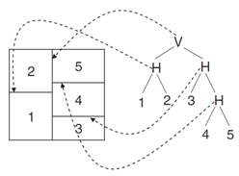
Slicing Tree Representation
A binary tree (complete)
Modules on leave nodes & Cutlines on internal nodes
1D expression by postfix traversal
Notes:
Now, we know the property of a slicing floorplan. We need to transform a slicing floorplan to a data structure that can represent the slicing floorplan. Now, vertical cut and horizontal cut are both binary operations, right? You apply a horizontal cut, the chip is separated to two parts, top and bottom. You apply a vertical cut, the chip is separated to two parts, left and right. So they are binary operations, and we can represent them in a tree structure, in a binary tree. A binary tree has a bunch of nodes, and each node has two children that represents the partition results of a vertical or horizontal cut. The tree is thus representing the entire cut of a slicing floorplan.

Slide 45
Postfix Traversal on a Binary Tree
Void postfix(Node* node) {
if(node == nullptr) return;
postfix(node->left_node);
postfix(node->right_node);
std::cout << node->id << ‘\n’;
}
Notes:
We can traverse a tree. There are many ways to traverse a tree. One of the methods we are talking about here is postfix traversal on a binary tree. Idea is very simple, you start from the root, and traverse all the way down to the entire tree. During the traversal, you go to the left subtree, and then right subtree. After you traverse all left and right subtrees, you process the node in the recursion. For this example, we simply print the id of this node.

Slide 46
Example
What is the postfix order of the slicing tree below?
Postfix expression?
Notes:
Postfix expression: 12H345HHV

Slide 47
Polish Expression
Succinct representation of slicing floorplan
Roughly specifying relative positions of blocks
Postorder traversal of slicing tree
1. Postorder traversal of left sub-tree
2. Postorder traversal of right sub-tree
3. The label of the current root
For n blocks, a Polish Expression contains n operands (blocks) and n-1 operators (H, V)
However, for a given slicing floorplan, the corresponding slicing tree (and hence polish expression) is not unique. Therefore, there is some redundancy in the representation
Notes:
This postfix traversal has another famous name, polish expression. (follows…)

Slide 48
Verify a Postfix Expression
How do we tell if a given postfix expression is valid?
12VH3: invalid
123VH: valid
1234567HHHHVV: valid
1HVVHHV743526: invalid

Slide 49
Floorplan Optimization
Chain: HVHVH… or VHVHV…
The moves:
M1: Swap adjacent operands (ignoring chains)
M2: Complement some chain
M3: Swap 2 adjacent operand and operator
M3 can give you some invalid NPE. Checking for validity after M3 is needed
It can be proved that every pair of valid NPE are connected
16H35V2HV74HV
Chains

Slide 50
Illustration
1
1
2
M1
4
5
5
3
4
3
2
34V2H5V1H
32V4H5V1H
M3
1
1
4
5
5
M2
3
2
3
2
4
32V45VH1H
32V45HV1H

Slide 51
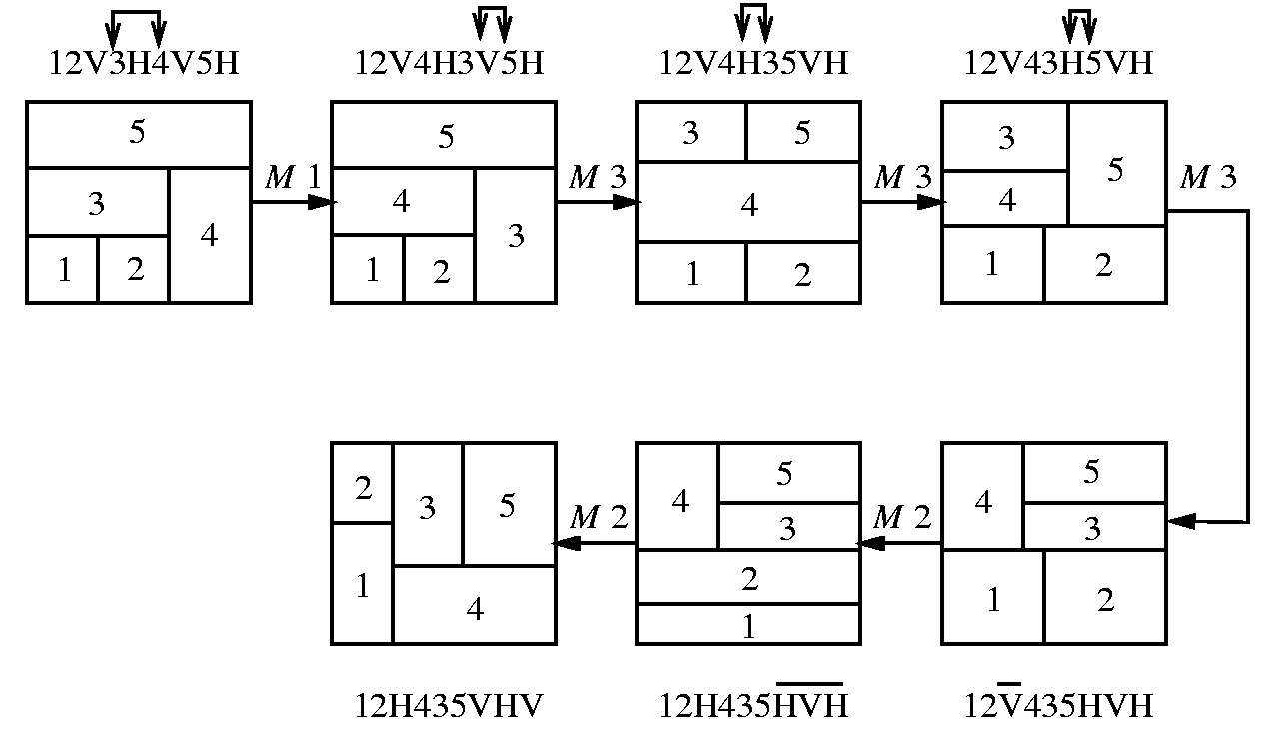
Solution Perturbation

Slide 52
Packing from a Postfix Expression
Binary operator
H: maximum on width and summation on height
V: maximum on height and summation on width
W₁₂
2
W₃₄
H
H₁₂
V
1
H₃₄
3
1
2
4
3
4
W₁₂= max(W₁ , W₂)
H₁₂= H₁ + H₂
W₃₄ = W₃ + W₄
H₃₄ = max(H₃ , H₄)
(a) Postfix expression: 12H
(b) Postfix expression: 34V
Notes:
Now, we know how to perturb a solution represented by a slicing tree. We havn’t convinced ourselves that, for a given polish expression, how do we convert it back to the 2D floorplan. An expression here is just a linear sequence of block numbers and cut type, either H or V. And we need to know the corresponding 2D floorplan.
52

Slide 53
Packing Two Sub-floorplans Recursively (I)
Binary operator
H: maximum on width and summation on height
V: maximum on height and summation on width
W₁₂₃₄
V
2
H₁₂₃₄
H
V
1
3
4
1
2
3
4
W₁₂₃₄ = W₁₂ + W₃₄
H₁₂₃₄ = max(H₁₂ , H₃₄)
(c) Postfix expression: 12H34VV
Notes:
53

Slide 54
Packing Two Sub-floorplans Recursively (II)
Binary operator
H: maximum on width and summation on height
V: maximum on height and summation on width
W₁₂₃₄
H
3
4
H
V
2
H₁₂₃₄
1
2
3
4
1
(d) Postfix expression: 12H34VH
W₁₂₃₄ = max(W₁₂ + W₃₄)
H₁₂₃₄ = H₁₂ + H₃₄
Notes:
54

Slide 55
Programming Assignment 1: Floorplan Optimization
Area minimization is the top priority!
Simulated Annealing (SA)
Randomly modify the slicing tree and select the one with the minimum floorplan area
We have provided you this optimization engine
1. Generate an initial slicing tree T
2. Calculate the area of the slicing tree T
3. Generate a random neighboring solution by changing the tree
4. Calculate the cost of the new neighboring solution
5. Compare them:
if new_area < old_area, then move to the new solution
else accept the new solution with a user-defined probability
6. Repeat steps 3-5 above until an acceptable solution is found
Notes:
55

Slide 56
Summary
Stack is a first-in-last-out data collection
pop: delete an item from the stack
push: insert an item into the stack
top: query the top item in the stack
Queue is a first-in-first-out data collection
pop: delete an item from the queue
push: insert an item into the queue
front: query the front item in the queue
Applications on compile expression parsing, VLSI design automation, and floorplan
Programming assignment 1 is out and is due on 2/27
Check class webpage for more details

